Slide 1


MARKET LEADERS
Top Developers & Their Contribution
₹12.77L Cr
₹1.15L Cr
₹12.6 Cr
Total Market Sales
Top Developer Contribution
Average Ticket Size
Overall market size across all developers
Consistent premium pricing across top tier
Individual sales from leading developers
Market Concentration
Top 5 developers—Prestige, Brigade, L&T Realty, Godrej, Embassy—dominate with majority of total ticket sales.
Strategic Focus
Prioritize partnerships and joint ventures with top performers. Mid-tier developers should adopt their pricing and amenity strategies.

Slide 2

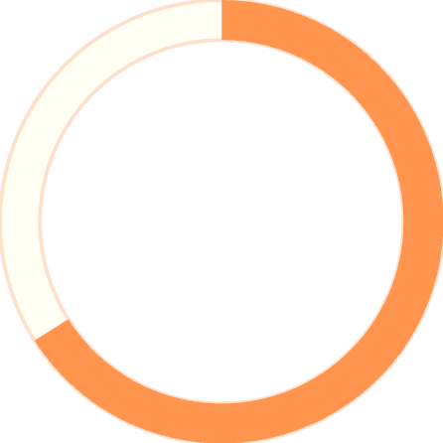
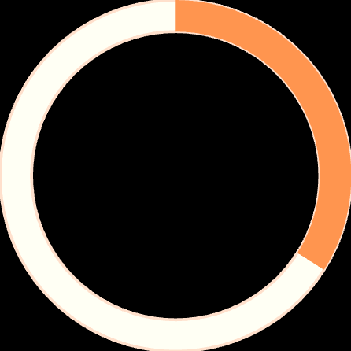
BUYER SENTIMENT
Mix of positive and negative comments
What Buyers Are Saying
Positive Highlights
Loved the amenities (~9K)
66%
Excellent location (~9K)
Great value (~9K)
No Comment
18.3K buyers—passively satisfied
Key Concerns
Too far from office (~9.3K)
Recommendation: Convert silent buyers into promoters. Address connectivity concerns in marketing. Use positive comments in sales collateral.
Connectivity is poor (~9K)
34%
Active Feedback

Slide 3

TIMING STRATEGY
Quarterly Performance Trends
1
Q1
Moderate activity, post-holiday recovery phase
2
Q2
Mid-year peak, strong booking volumes
3
Q3
Festival season momentum builds
4
Q4
Year-end surge, highest conversions
Key Insight
Action Plan
Booking trends show clear seasonality with mid-year and year-end peaks. No single quarter dominates consistently—market timing matters.
Align new launches and promotions with strong quarters. Use weaker periods for pre-launch marketing, lead generation, and inventory buildup.

Slide 4

BUYER SEGMENTS
Who Should We Focus On?
CXO
₹0.25M total ticket sales. High volume segment with strong conversion rates.
NRI
₹0.26M total ticket sales. Premium segment with high ticket stability.
HNI
₹0.25M total ticket sales. Consistent premium buyers seeking exclusivity.
Startup Founders
₹0.26M total ticket sales. Growing segment with volume potential.
Strategic Approach: Maintain multi-segment targeting. Focus premium amenities on NRI & HNI buyers. Use pricing flexibility and financing offers for CXO & Startup segments.

Slide 5

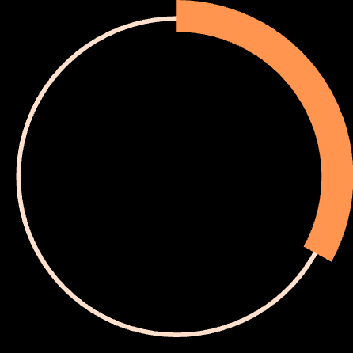


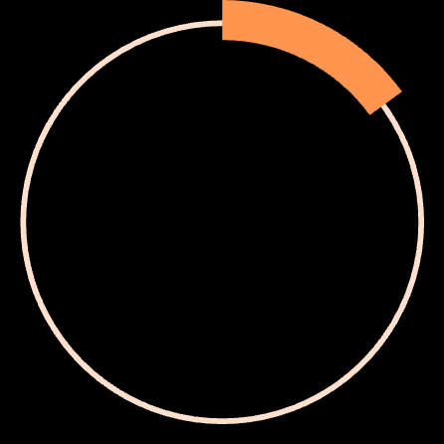
CONFIGURATION MIX
What Sells & What Needs Push?
33%
Volume leader
3BHK
Volume Strategy
Premium Push
33%
Continue prioritizing 3BHK & 4BHK for volume-driven projects and mass market appeal.
Increase 5BHK+ demand by targeting HNI/NRI buyers, bundling premium amenities, and positioning exclusivity over discounts.
Volume leader
4BHK
15%
Highest margin
5BHK+

Slide 6

TOP MARKETS
Top 10 Micro-Markets
Demand Concentration Leaders
Sarjapur Road
JP Nagar
Bannerghatta Road
Leading in project count and ticket sales
Established market with strong demand
High booking volumes consistently
Whitefield
Indiranagar
IT corridor with premium positioning
Premium micro-market leader
Strategic Priority: Prioritize inventory expansion and premium launches in these top 10 micro-markets. Use them as benchmark markets for pricing, configuration, and amenities across portfolio.

Slide 7

GROWTH OPPORTUNITY
Improving Lower-Performing Markets
Current Challenges
Improvement Strategy
Lower booking counts
01
Significantly below top market performance
Enhance Amenities
Reduced ticket sales
Upgrade offerings to match top market standards
Revenue generation lags behind leaders
02
Optimize Sales Mix
Amenity gaps
Balance Direct and Broker channel focus
Lower amenity scores compared to top markets
03
Connectivity issues
Competitive Pricing
Poor infrastructure and access concerns
Strategic pricing or phased inventory release
04
Targeted Marketing
Focused campaigns instead of broad approach

Slide 8
CHANNEL STRATEGY
Sales Channel Efficiency
Online
Broker
Direct
NRI Desk
~25K projects. Digital-first buyers with high research intent.
~25K projects. Traditional channel with established networks.
~25K projects. Walk-ins and referrals with high trust factor.
~25K projects. Specialized service for overseas buyers.
Key Insight
Recommendation
All channels generate similar project volumes. Conversion efficiency—not volume—is the differentiator.
Invest in channel training and quality leads. Optimize messaging by channel instead of uniform campaigns across all touchpoints.

